Slide 1
Robot Movement Simulation in a Warehouse
Azeem Husain Khan

Slide 2
Introduction
Overview:
Simulating a robot navigating from a start position to a destination in a defined warehouse.
Visualizing the path taken by the robot using Matplotlib.
Key Concepts:
Robot movement calculation based on speed and distance.
Visualization of the robot’s path and destination.

Slide 3
Code Explanation (Setup and Parameters)
Warehouse Dimensions: warehouse_width = 10
warehouse_height = 10
Defines the size of the warehouse (10x10 units).
Robot Specifications: robot_speed = 4
update_interval = 0.1
Sets the robot's speed and how often the plot updates during simulation.
Starting and Ending Positions: start_position = (0, 0)
end_position = (7, 9)
The robot starts at the bottom-left corner and moves towards the position (7, 9).

Slide 4
Movement Logic
Function: move_robot def move_robot(current_position, target_position):
Input: Current position of the robot and the target position.
Process:
Calculates the distance to the target using Euclidean distance.
Determines the direction to move and updates the robot’s position based on its speed.
Output: New position of the robot after moving.
Simulation Loop: while robot_position != end_position:
Continuously updates the robot's position until it reaches the target.
Updates the plot every 5 steps for efficiency.

Slide 5
Visualization and Results
Plot Setup: fig, ax = plt.subplots(figsize=(6, 6))
ax.set_xlim(0, warehouse_width)
ax.set_ylim(0, warehouse_height)
Creates a 6x6 plot representing the warehouse space.
Marking the Destination and Path: ax.plot(end_position[0], end_position[1], 'gx', markersize=10, label="Destination")
path_line, = ax.plot([], [], 'b-', label="Path")
robot_marker, = ax.plot([], [], 'ro', markersize=8, label="Robot Position")
Marks the destination with a green 'X' and initializes lines for the path and robot position.
Final Visualization:
Once the robot reaches its destination, the final plot displays the complete path taken by the robot.

Slide 6
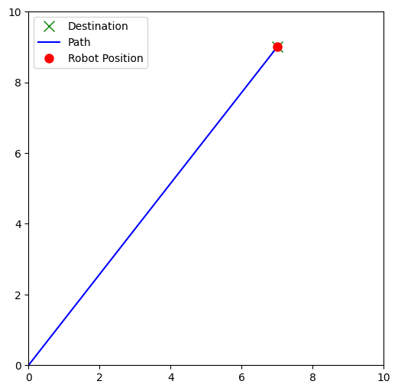
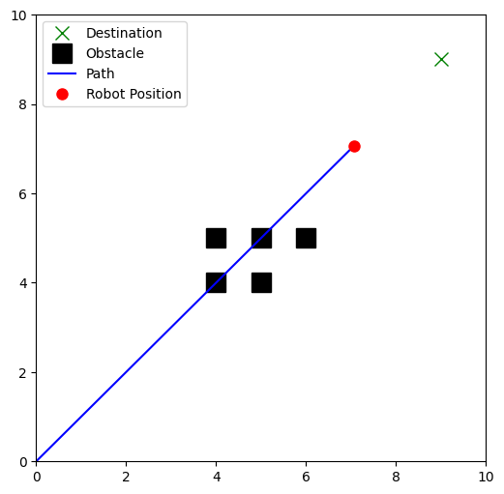
Output

